Slide 1
British Airways Insights
Johnny Yang

Slide 2
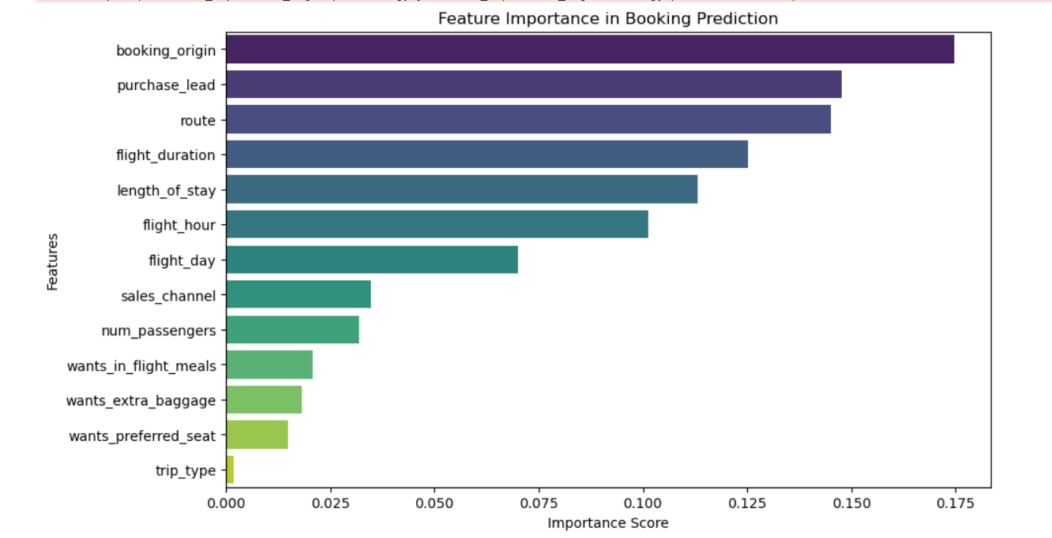
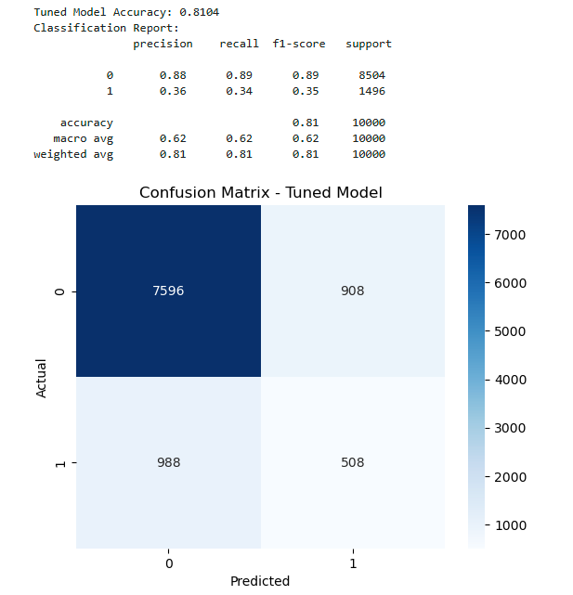
Summary of Findings
Objective: Create a model to predict customer bookings
Top 5 factors that influence booking:
Booking origin, purchase lead, route, flight duration, and length of stay
Model Used: Random Forest (Tuned with GridSearchCV)
Accuracy: 81.04%
Class Imbalance Observed: Only 14.96% of bookings were completed (class 1).
Metrics Breakdown:
Precision for Class 1: 36% (Only 36% of predicted completed bookings were correct)
Recall for Class 1: 34% (The model identified only 34% of actual completed bookings)
F1-Score: 35% (Balanced measure of precision and recall)

